Slide 1

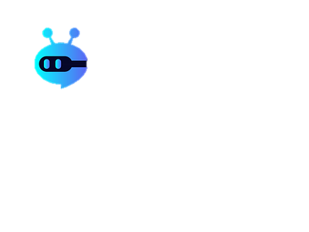
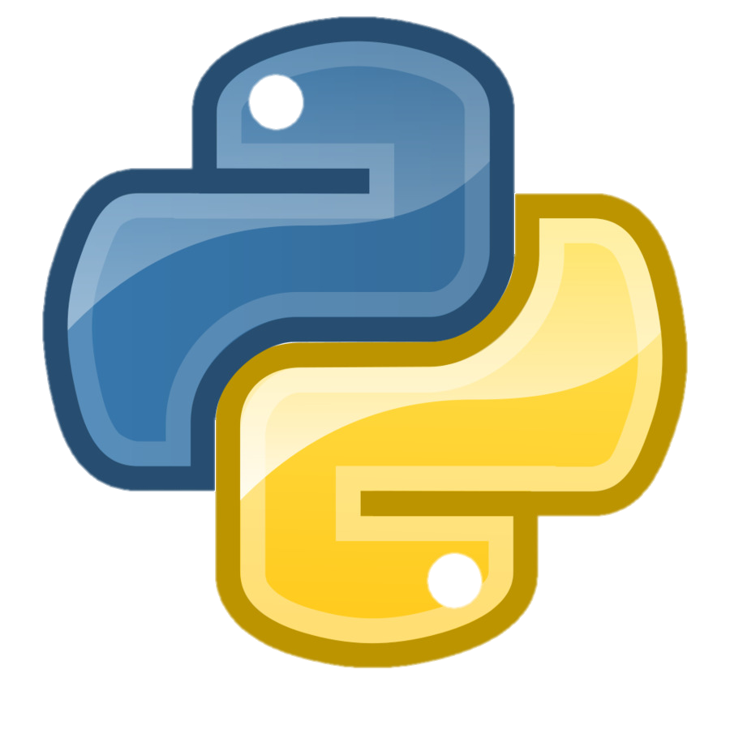
Chat bot
With
Python

Slide 2

Group members:
Warisha,Wania
Project Name:
Chat bot
Project detail

Slide 3
What is chat bot:
A chatbot is a software program that simulates conversation with users, typically using artificial intelligence and natural language processing technologies.
What is the purpose of a chat bot:
The purpose of a chatbot is to interact with users in a conversational manner, providing information, assistance, or performing tasks
based on user input. They can streamline processes, improve customer service, provide information, automate tasks, and enhance user engagement on websites, apps, and messaging platforms.

Slide 4
Why we use chat bot:
Chatbots are used for various reasons:
Automation: They automate tasks, reducing the need for human intervention in repetitive processes like customer support inquiries, appointment scheduling, or order tracking.
24/7 Availability: Chatbots can operate round the clock, providing immediate assistance to users regardless of time zones or working hours.
Scalability: They can handle multiple conversations simultaneously, allowing businesses to scale their customer support or engagement efforts without linearly increasing manpower.
Cost Efficiency: Chatbots can reduce operational costs by handling routine inquiries, freeing up human agents for more complex tasks and reducing the need for additional staff.
Enhanced User Experience: They provide quick responses and personalized interactions, leading to improved user satisfaction and engagement.
Data Collection: Chatbots can gather valuable data about user preferences, behavior, and issues, which can be used for analytics, product improvement, and targeted marketing.
Convenience: Users can get information, make purchases, or complete tasks conveniently through familiar messaging platforms without switching to other interfaces.
Overall, chatbots offer businesses a means to streamline processes, improve customer service, and enhance user experiences, leading to increased efficiency and satisfaction.

Slide 5

Code of chatbot:
Define a function to respond to user inputdef chatbot_response(user_input): greetings = ["hi", "hello", "hey", "hola"] responses = ["Nice to meet you!", "Hello!", "Hi there!", "Hey! How can I help you?"] if user_input.lower() in greetings: return random.choice(responses) else: return "I'm just a simple chatbot. Say 'hi' to start a conversation!"# Main loop to keep the chatbot runningwhile True: user_input = input("You: ") if user_input.lower() == 'bye': print("Chatbot: Goodbye!") break else: print("Chatbot:", chatbot_response(user_input))

Slide 6

A real-life example of a chatbot is the automated customer service assistant used by a telecommunications company. Customers can ask questions or seek assistance via chat on the company's website or app, and the chatbot responds instantly wit h helpful information, such as billing details, technical support, or account inquiries.Some examples of Chatbots are:Lyro, Kuki, Blenderbot, Siri

Slide 7
THANK YOU

